Slide 1
Lim Yu Zheng
General Assembly (Data Science Immersive 11)
Nov19-Jan20
Capstone Project: E-commerce end-to-end Marketing Strategy
Customer Segmentation, Recommendation System, Market Basket Analysis

Slide 2
Outline
3 Business Problems
Data Analytics/Science
EDA, Data Cleaning, Feature Engineering
Modelling & Evaluation
Conclusion
Deployment
Dataset: UCI Retail Dataset 542k rows: https://archive.ics.uci.edu/ml/datasets/online+retail (used for this project), or 1.07m rows: https://archive.ics.uci.edu/ml/datasets/Online+Retail+II . 8 features for both

Slide 3
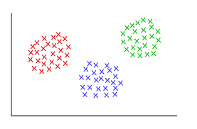


Business Problems
Customer segmentation: How can we segment customers, into different clusters, so as to deliver tailored marketing strategies, so as to minimise promotional costs/retain loyal customers/raise revenue?
Product Recommendation: How can we also make personalised product recommendations, so as to raise revenue?
Continued customer engagement: How can we FURTHER engage customers through email/promotion campaigns, so as to raise revenue?

Slide 4
P1. Customer Segmentation
P1. Customer Segmentation
Approach: RFM, Kmeans, DB-Scan Evaluation: Elbow method, Silhouette Score Conclusion: Kmeans’ 5 clusters best (Silhouette score: 0.58)
Marketing Dashboard deployed online on ‘Tableau Public’
 | Recency (days since last purchase) | R | Freq (no. of transactions) | F | Monetary (total spend) | M | RFM combined
Person A | 0 | 1 | 10 | 1 | $10 | 1 | 111
Person B | 3 | 2 | 7 | 2 | $7 | 2 | 222
Person C | 7 | 3 | 3 | 3 | $3 | 3 | 333
Person D | 10 | 4 | 0 | 4 | $0 | 4 | 444
RFM:
Split into eg. 4 quartiles, then rank based on %tile

Slide 5
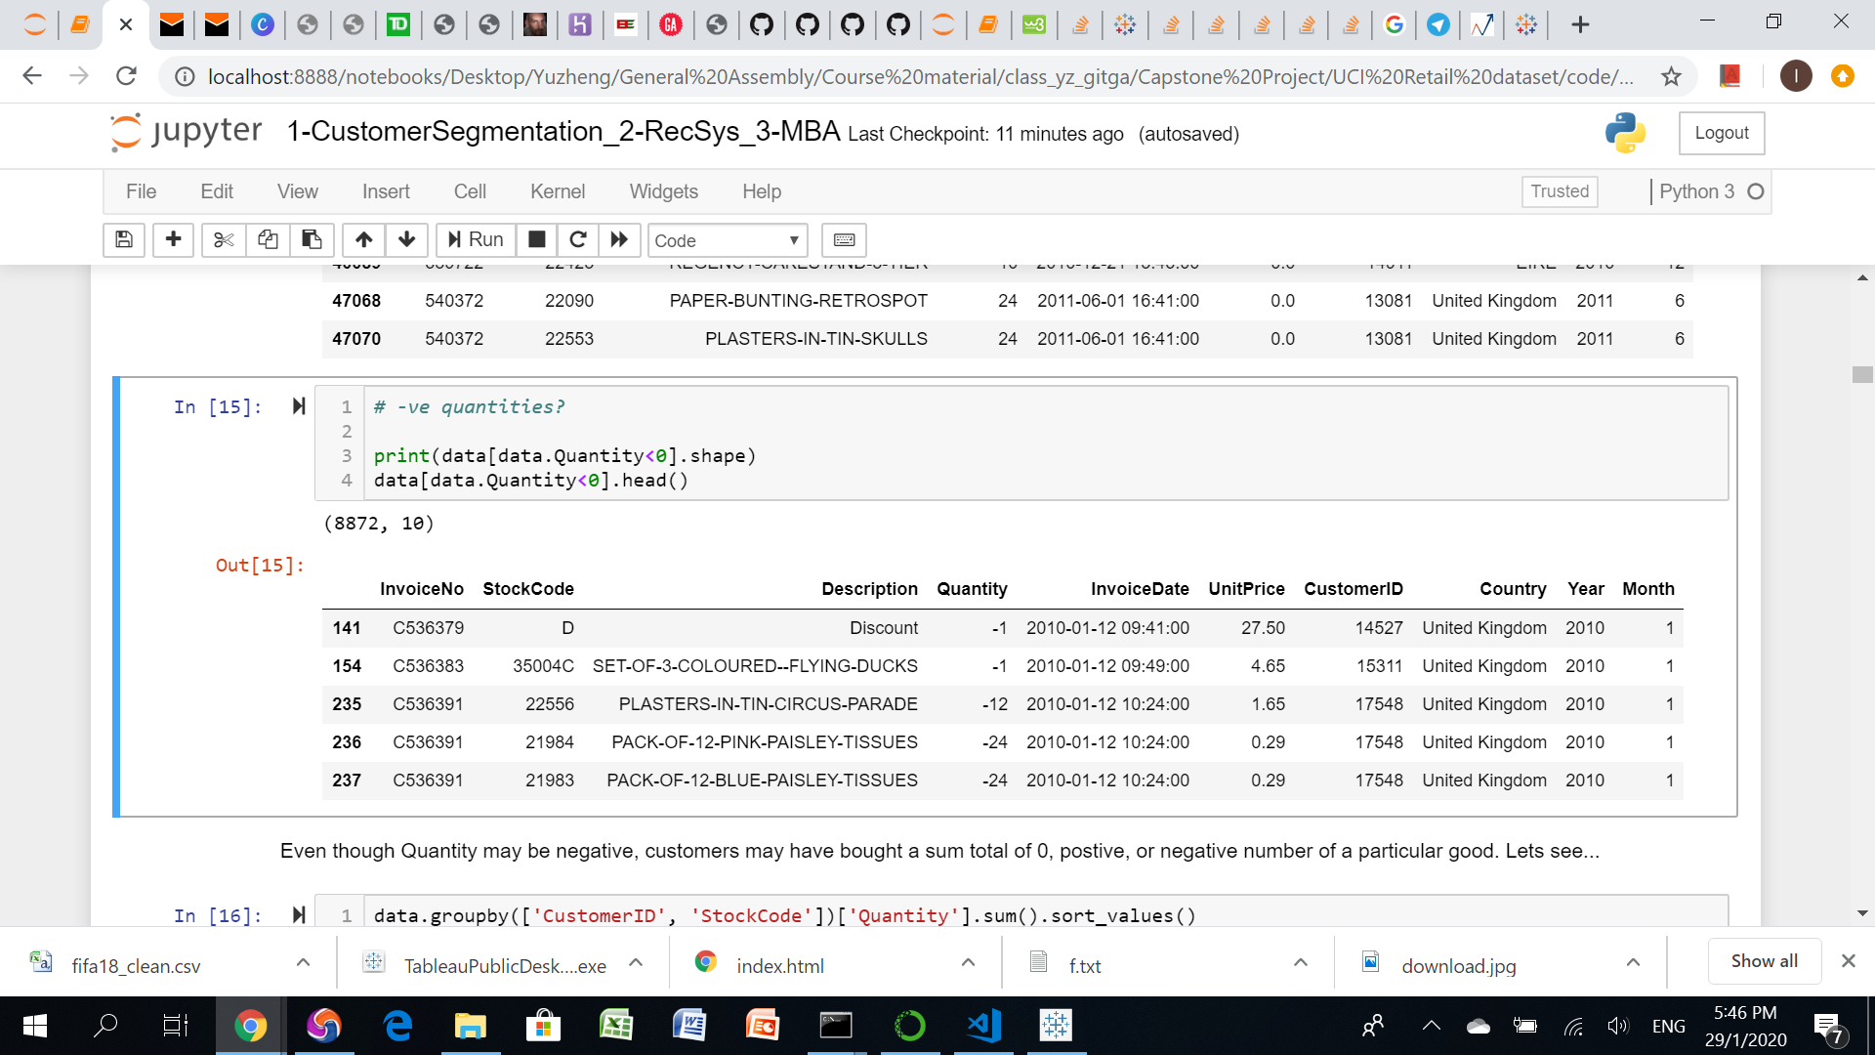
EDA, Data cleaning, Feature Engineering
P1. Customer Segmentation
-removed nulls for CustomerID, because without ID we can’t identify them -removed duplicated rows -identical products have variations in StockCode/Description, hence commonized StockCode, Description for such products -Some product purchases have a mix of +ve/-ve Quantities, hence summed Customers’ purchases for each product, and removed those that are still sum -ve -created TotalPrice column, via UnitPrice x Summed Quantity -created Year, Month columns from InvoiceDate -created R,F,M columns for each customer -scaled R,F,M values (for Kmeans, DB-Scan)
Original dataset:

Slide 6
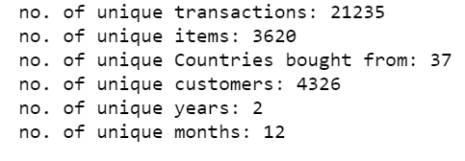
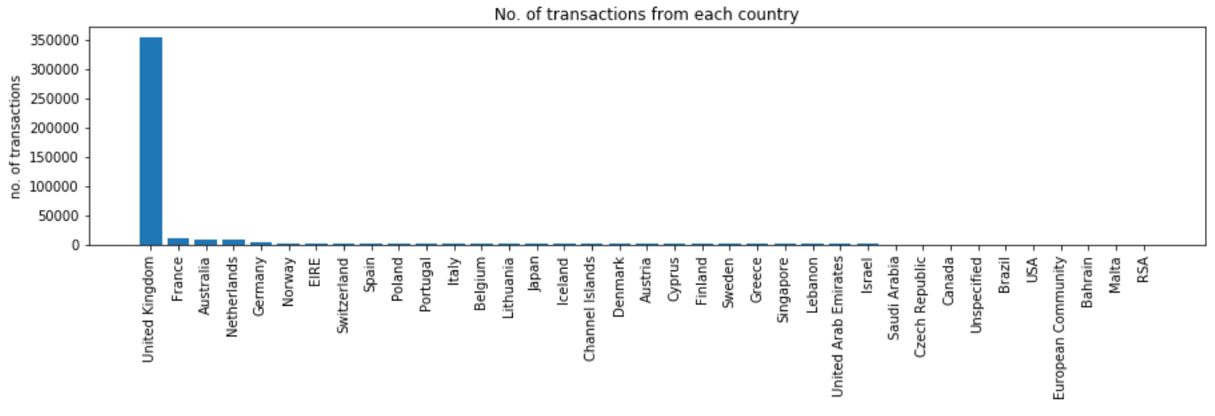
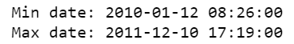
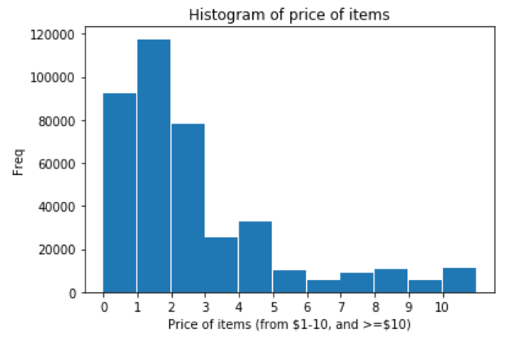
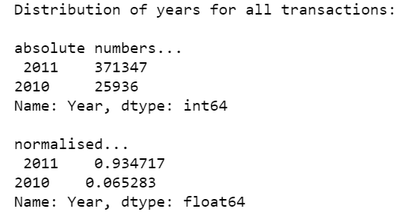
Post-cleaning EDA
P1. Customer Segmentation

Slide 7
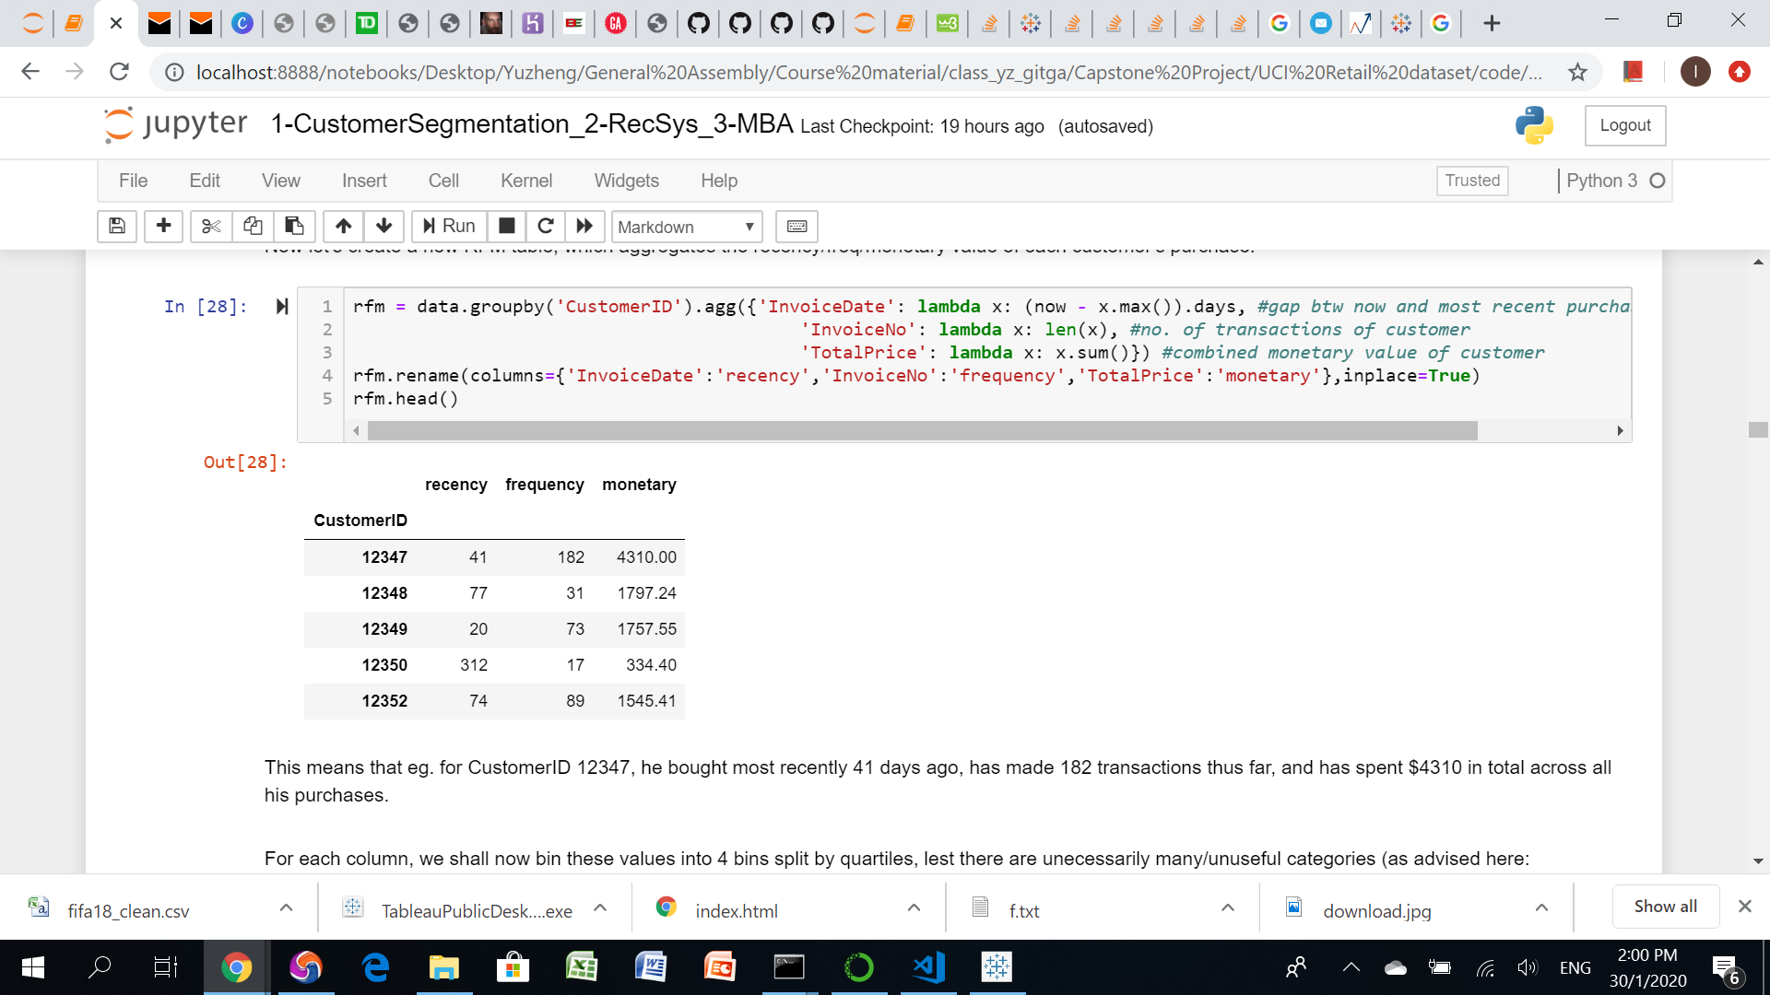
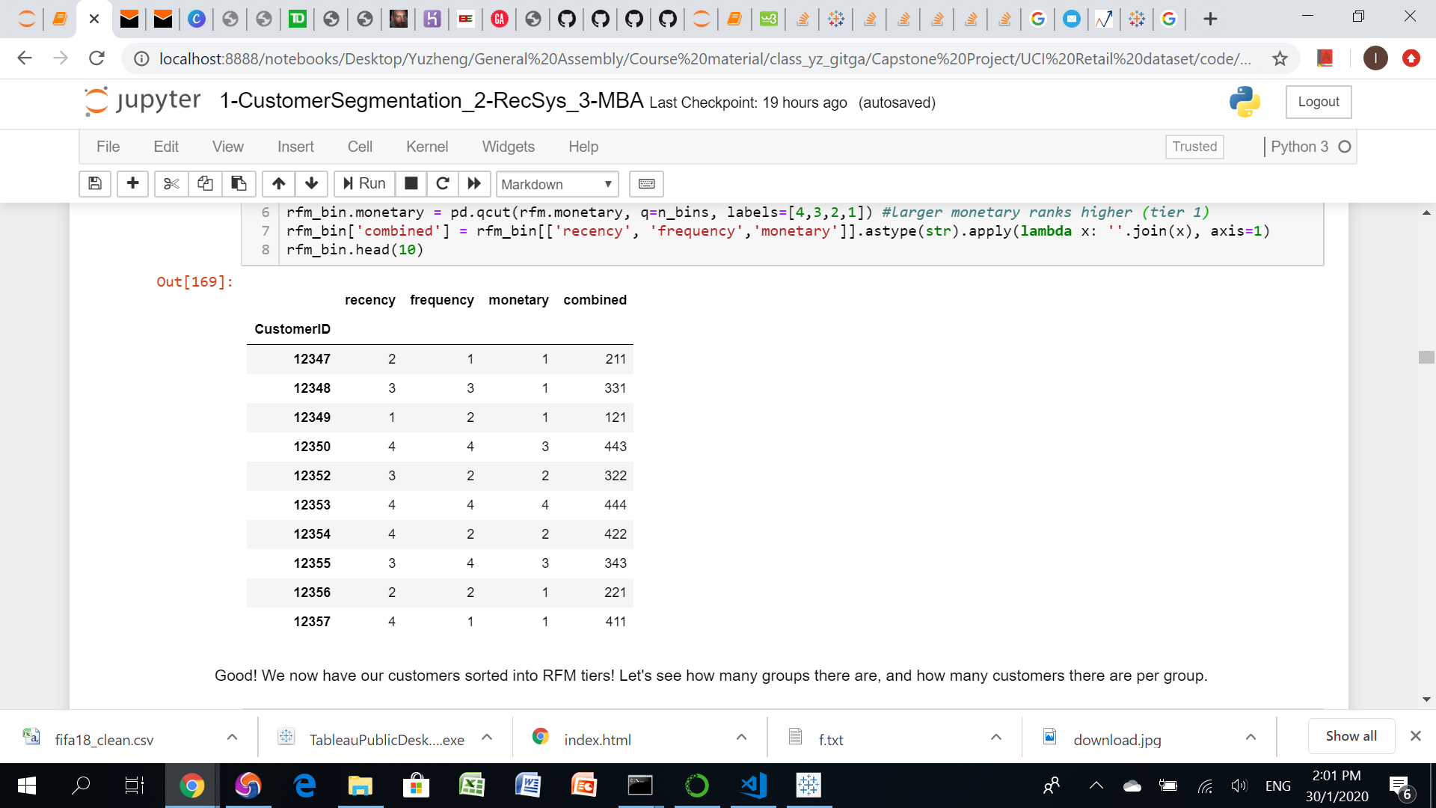

RFM (baseline model)
P1. Customer Segmentation
Downsides: -very similar spenders at edge of eg. M tiers 1&2, may wrongfully be sorted into different groups -HUUUGE no. of groups (up to 4x4x4=64 combinations) to manage for marketing team

Slide 8
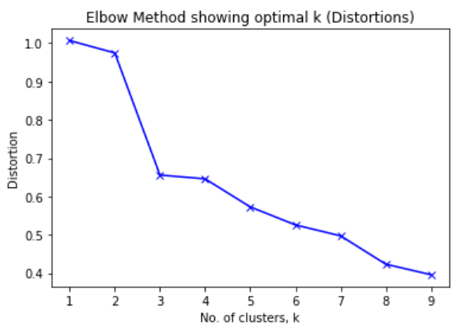
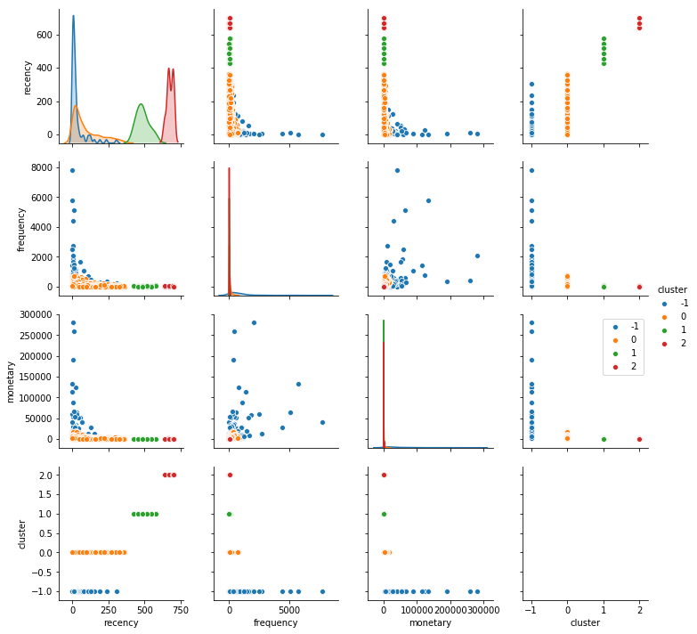
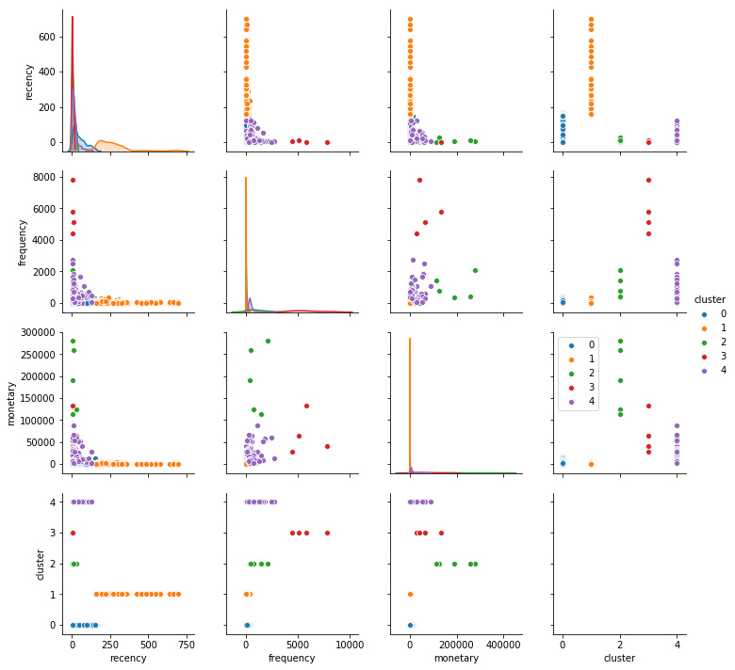
Kmeans
DB-Scan
Evaluate other models...
P1. Customer Segmentation
Gridsearch. Try 1-10 clusters... Elbow: Silhouette score: 5 clusters best? (best score of 0.58)
Gridsearch. Try eps: [0.02, 0.1, 0.4], min_samples: [2,5,9] Silhouette score: 3 clusters best? (best score of 0.62, best params eps=0.4, min_samples=9)
3 clusters best?
BUT!!!
As rule of thumb, 3 clusters is too few! Typically ~8! SO… Use 5 clusters.

Slide 9
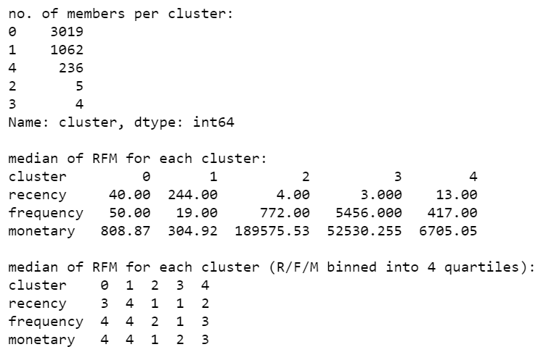
P1. Conclusion & Recommendations
Rank clusters’ median RFM into RFM tiers...
P1. Customer Segmentation
Industry’s marketing-strategy recommendations for each cluster: A. Core - Your Best Customers (none from kmeans!) - RFM group: 111 - Who They Are: Highly engaged customers who have bought the most recent, the most often, and generated the most revenue. - Marketing Strategies: Focus on loyalty programs and new product introductions. These customers have proven to have a higher willingness to pay, so don't use discount pricing to generate incremental sales. Instead, focus on value added offers through product recommendations based on previous purchases. B. Loyal - Your Most Loyal Customers (kmeans cluster 3!) - RFM group: X1X - Who They Are: Customers who buy the most often from your store. - Marketing Strategies: Loyalty programs are effective for these repeat visitors. Advocacy programs and reviews are also common X1X strategies. Lastly, consider rewarding these customers with Free Shipping or other like benefits. C. Whales - Your Highest Paying Customers (kmeans cluster 2!) - RFM group: XX1 - Who They Are: Customers who have generated the most revenue for your store. - Marketing Strategies: These customers have demonstrated a high willingness to pay. Consider premium offers, subscription tiers, luxury products, or value add cross/up-sells. Don't waste margin on discounts. D. Promising - Faithful customers (none from kmeans!) - RFM group: X13, X14 - Who They Are: Customers who return often, but do not spend a lot. - Marketing Strategies: You've already succeeded in creating loyalty. Focus on increasing monetization through product recommendations based on past purchases and incentives tied to spending thresholds (pegged to your store AOV). E. Rookies - Your Newest Customers (none from kmeans!) - RFM group: 14X - Who They Are: First time buyers on your site. - Marketing Strategies: Most customers never graduate to loyal. Having clear strategies in place for first time buyers such as triggered welcome emails will pay dividends. F. Slipping - Once Loyal, Now Almost Gone (none from kmeans!) - RFM group: 44(1/2) - Who They Are: Great past customers who haven't bought in awhile. - Marketing Strategies: Customers leave for a variety of reasons. Depending on your situation price deals, new product launches, or other retention strategies. G. Lost - Not worth keeping (kmeans cluster 0,1!) - RFM group: (3/4)44 - Who They Are: Lost customers who spent little, infrequently - Marketing Strategies: Don't waste huge marketing efforts on them H. Others - (kmeans cluster 4!) - RFM group: others - Who They Are: others - Marketing Strategies: No particular strategy. Maintain status quo
Best model: Kmeans
https://www.barilliance.com/rfm-analysis/#tab-con-1

Slide 10

P2. Product Recommendation
P2. Product Recommendation
Approach: Collaborative Filtering (data only has purchased qty: ‘implicit feedback’) Evaluation: Mean Precision@k (& less importantly Mean Recall@k, Mean AUC) Conclusion: Best model achieved mp@k=88% (& mr@k=51%, mAUC=100%)
Used fashion company Lyst’s LightFM library, for implicit feedback for recommendation engines. -matrix factorisation -inbuilt mp@k, mr@k, mauc scoring functions -inbuilt prediction/recommendation functions -outperforms both collaborative and content-based models in cold-start or sparse interaction data scenarios
Mock E-commerce website with recommendation engine deployed on ‘http://uci-retail-recommender.herokuapp.com/’

Slide 11
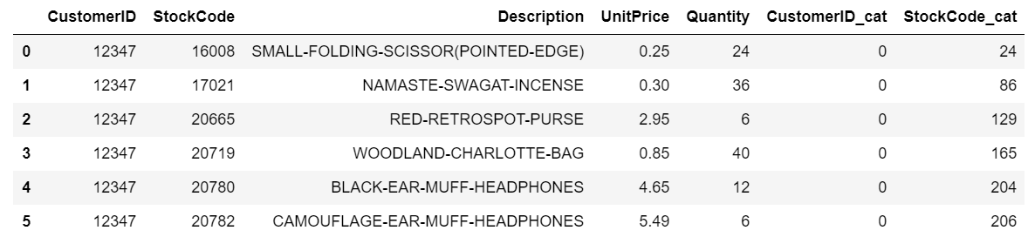
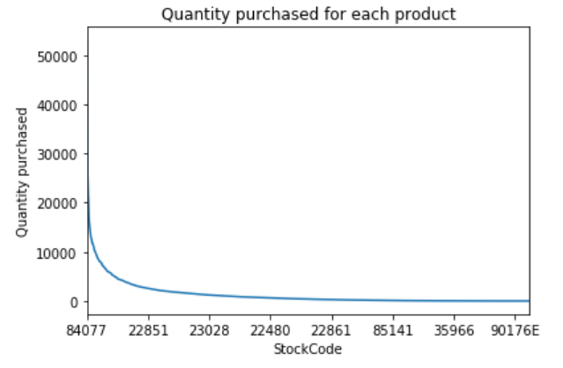
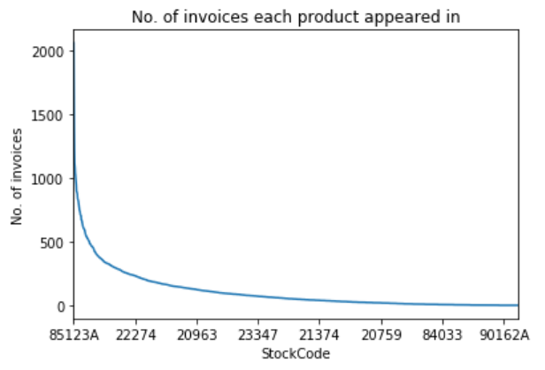
EDA, Feature Engineering
P2. Product Recommendation
-already cleaned prior -aggregated each customer’s purchases of the same item, together, then binarized purchases into 1 (bought that product) and 0 (didn’t buy it) -converted to sparse matrix (required by lightfm) -noticed long tail effect (only a few products have interactions with customers)
Many products not purchased in large amounts...
...nor frequently

Slide 12
BPR (baseline model)
P2. Product Recommendation
 | mp@k | mr@k | mauc
BPR (baseline) | 0.37 | 0.06 | 0.84
-BPR model: it optimises AUC score -Baseline because: AUC measures the quality of the overall ranking (though without regard for top-k rankings). That by and large, most recommendations are relevant. BUT!!! -p@k is more important, because customers won’t scroll to page 99 to find your recommendations. Need to prioritize relevant items at top of 1st page, to best ensure their purchase. Hence, use... -WARP, k-OS WARP models: they optimise mp@k by prioritizing top-k recommended items

Slide 13
P2. Model evaluation & Conclusion
P2. Product Recommendation
-set k=10. Meaning, ‘Serve top 10 recommendations’ -Baseline BPR vs the rest. -default hyperparameters -10 epochs -Gridsearch. Hyperparameter tuning of WARP, k-OS WARP -models: [WARP, k-OS WARP] -no. of latent features: [100,150,200] -learning schedules: [adagrad, adadelta] -50 epochs
 | mp@k | mr@k | mauc
BPR (baseline) | 0.37 | 0.06 | 0.84
WARP | 0.34 | 0.06 | 0.89
k-OS WARP | 0.27 | 0.05 | 0.85
Best model is...
WARP, 200, adadelta | 0.88 | 0.51 | 0.100

Slide 14
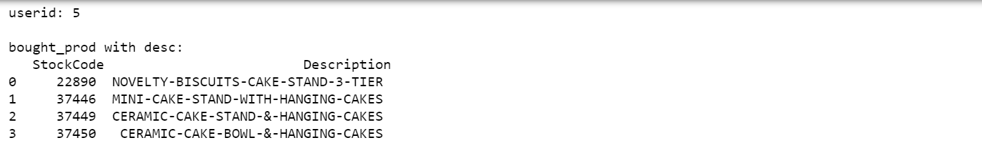
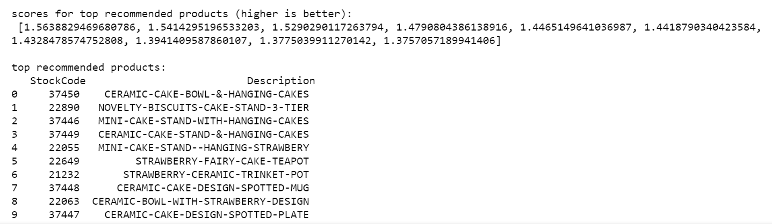
Test our recommendation engine!
P2. Product Recommendation
Eg. Customer 5 Previously bought: ‘Closeness’ scores of recommended products… Recommended products:
Max possible p@k of 40% obtained! (repeat & take mean of everyone’s p@k)
Other recommendations also highly cake-related! Looks sensible!
Finally, scrape images using product Descriptions, & deploy on Heroku

Slide 15
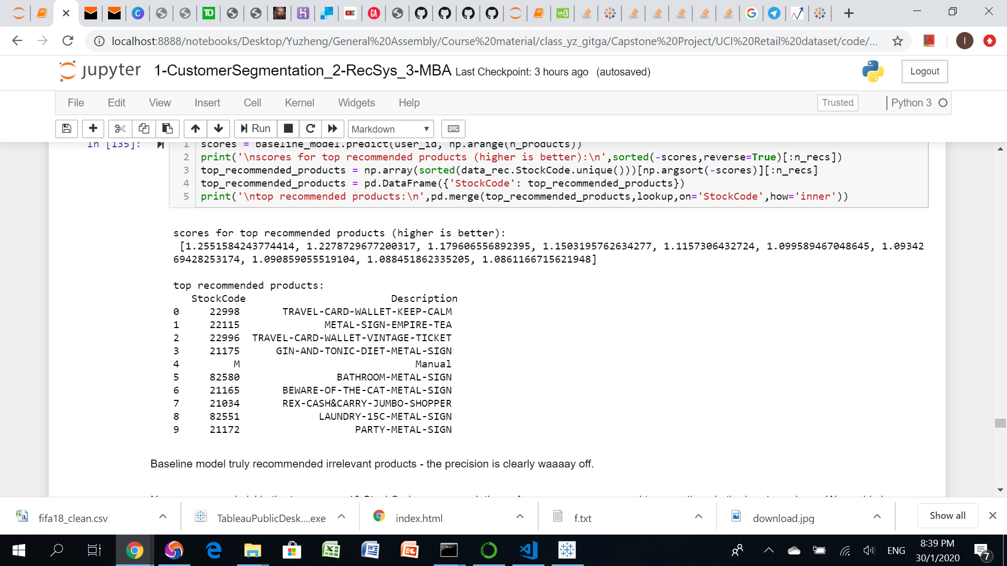
Compare with baseline model...
P2. Product Recommendation
Eg. Customer 5 Previously bought: ‘Closeness’ scores of recommended products… Recommended products:
Absolutely no hits! Nor seemingly sensible recommendations!

Slide 16
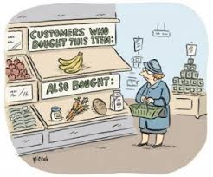
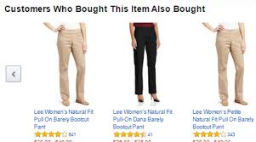
P3. Continued Customer Engagement
P3. Continued Customer Engagement
Approach: Apriori algorithm. Used for Market Basket Analysis (MBA) Evaluation: Support, Lift Conclusion: See generated list of highly associated products. For use in email/marketing campaigns (AND on website too) to bundle product recommendations together
Different from content-based/collaborative filtering!
Deployed in email-marketing campaign, & mock e-commerce website.

Slide 17
Evaluation metrics for MBA
P3. Continued Customer Engagement
-Support (range [0,1]): fraction of all transactions that contain both products A and B.
Higher better. Hence more data to draw conclusions about their relationship.
-Lift (range [0,infinite)): greater lift indicate stronger associations between A and B.
>1 better. Indicates that it’s not just a coincidence, and there is indeed a high association between items A and B. High chance of buying B if the customer has already bought A.

Slide 18
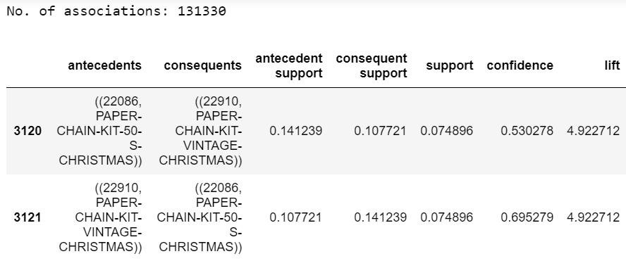
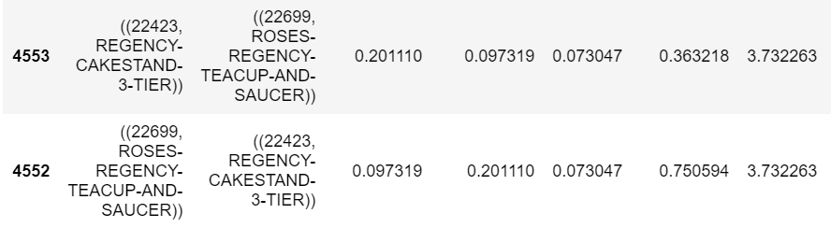
Product associations generated...
P3. Continued Customer Engagement
Sort support from high to low
Product A
Product B
Seek lift>1
Associated products!

Slide 19
P3. Conclusions & Recommendations
P3. Continued Customer Engagement
Marketing strategies! When promoting Product A, also cross-sell its associated Product B, to boost overall sales, for:
Email marketing
General marketing
‘Checkout’ page on e-commerce website

Slide 20
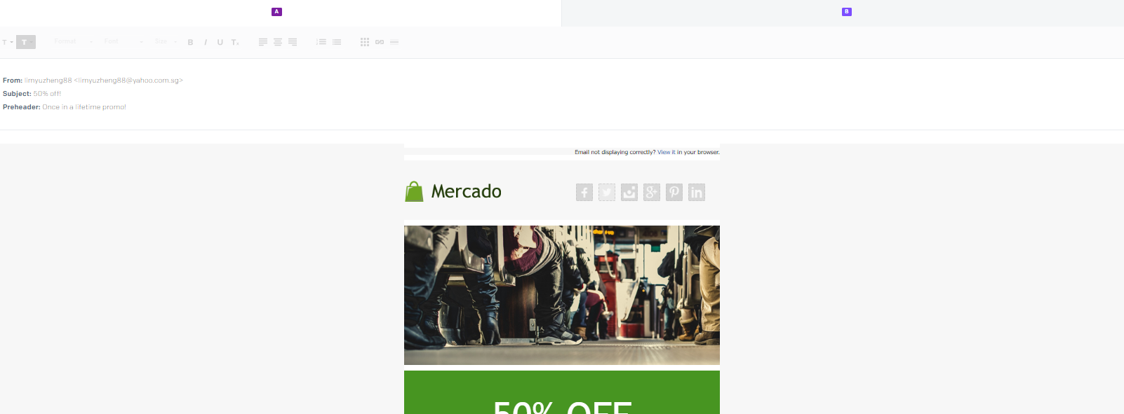
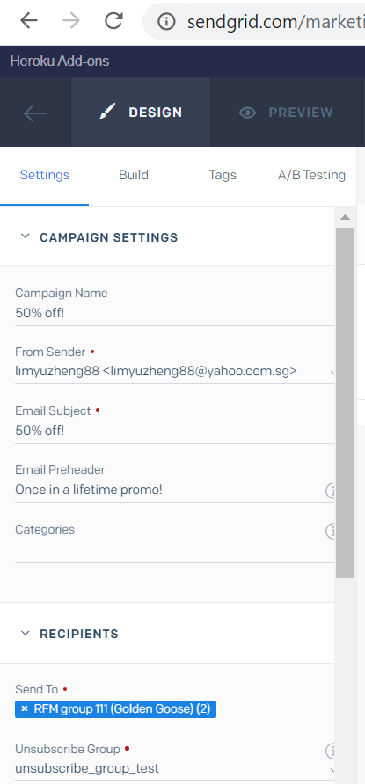
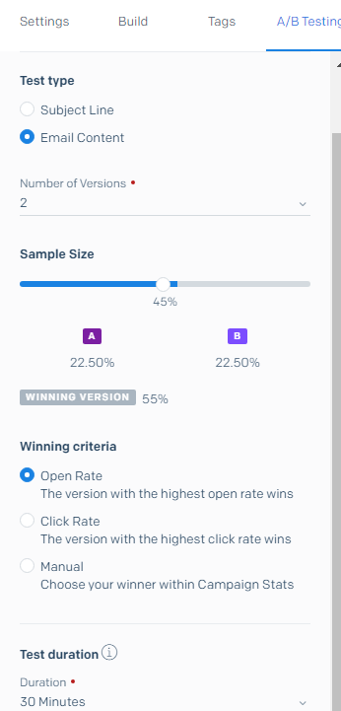
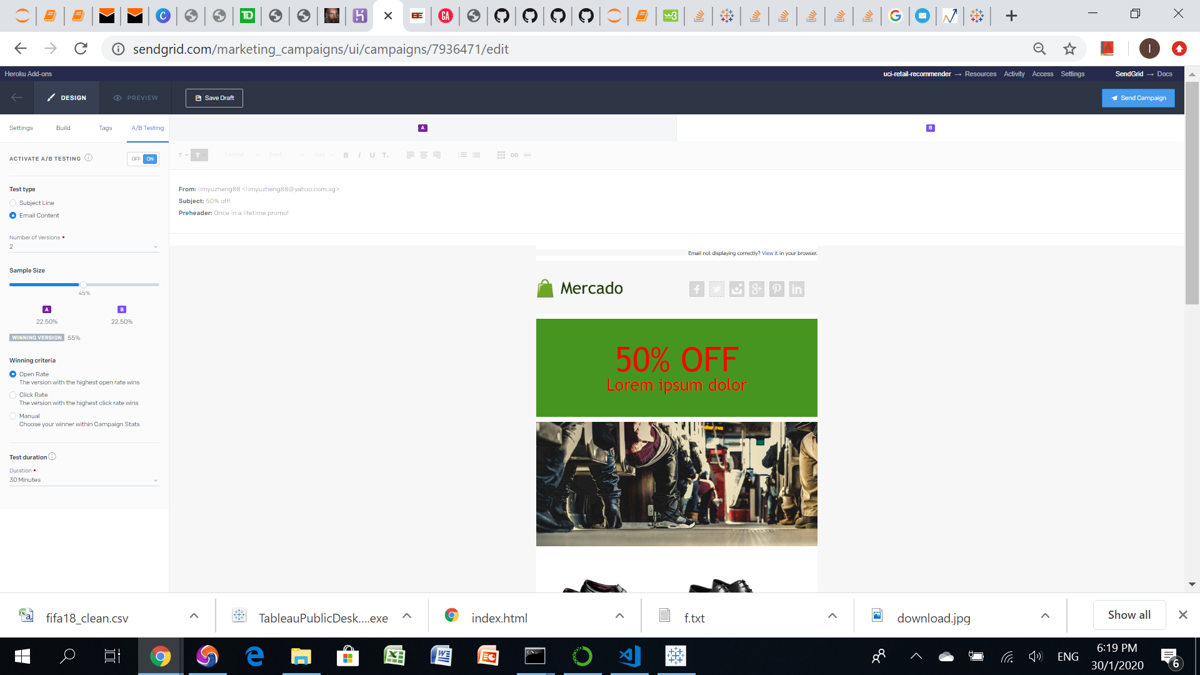
Email-marketing campaign demo
P3. Continued Customer Engagement
-Heroku’s ‘Sendgrid Marketing Campaign’ add-on. A/B testing & analytics
Version A
Winner...
Vary email content/design/header etc
Version B
Choose customer segment to send to
A/B testing: vary winning criteria, campaign duration etc

Slide 21
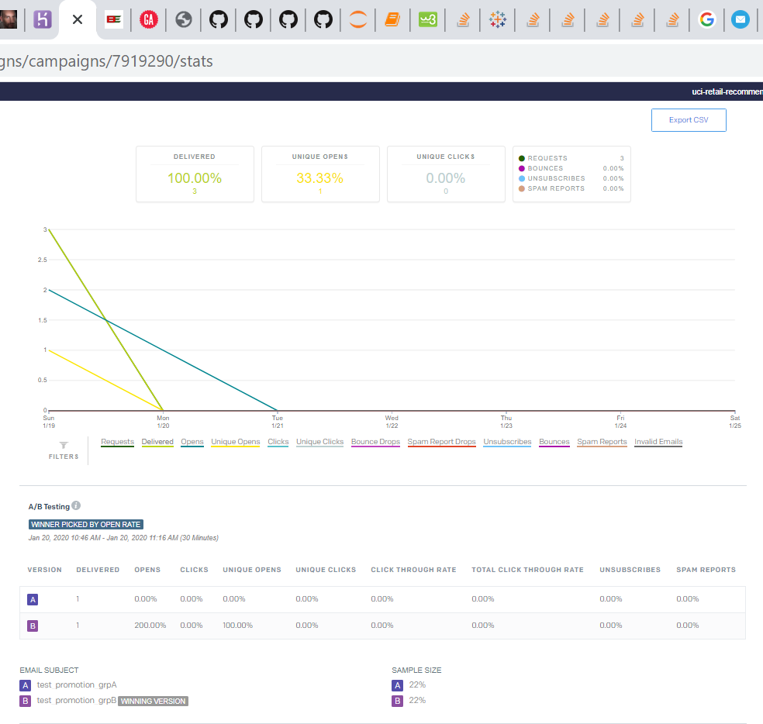
View winner of email campaign A/B testing
P3. Continued Customer Engagement
Version B wins!

Slide 22
Putting everything together...
Sendgrid Email Marketing Campaign
-MBA
-A/B testing
General Marketing
-MBA
E-commerce Website
-Product recommendation
-MBA
Tailored marketing
Marketing Dashboard
Customer segments
-Kmeans

Slide 23
Deployment
-Marketing dashboard: https://public.tableau.com/profile/lim.yu.zheng#!/vizhome/UCI-retail-recommenderMarketing-Dashboard/Story1?publish=yes
-Mock e-commerce website with collaborative-filtering recommendation engine, and Market Basket Analysis recommendations: http://uci-retail-recommender.herokuapp.com/
-Email marketing campaign control page is accessed by my id & pswd, not shareable

